Slide 1
Introduction to Bryophytes
Brief Background
Traditionally, the term plants was used for a wide variety of organisms including the algae and fungi, but now modern botanists confine the term to mosses, ferns, cone-bearing plants and flowering plants, as well as the various relatives of each of these groups.
Most modern textbooks, therefore, group members of the Plant Kingdom into three main categories:
Non-vascular plants, i.e. mosses and their relatives (Byrophytes)
Seedless vascular plants, i.e. ferns and their relatives (Pteridophytes)
Seed plants, i.e. cone-bearing plants (Gymnosperms) and flowering plants (Angiosperms)

Slide 2
Introduction to Bryophytes
General Characteristics of Plants including Bryophytes I
Members of the Plant Kingdom are more complex and varied in form than those of other kingdoms. Their tissues are more specialized for photosynthesis, conduction, support, anchorage and protection.
Plants share a number of common characteristics with green algae, which suggests that plants descended either from a remote common ancestor or perhaps several different, but related members of the green algae that successfully invaded terrestrial habitats.
Like green algae, plants have chlorophyll a as their primary photosynthetic pigment and chlorophyll b and carotenoids as accessory pigments.
The deposition of starch, the primary carbohydrate food reserve, within chloroplasts is a unique characteristic shared by plants and green algae.
As in some genera of green algae, the principal component of plant cell walls is cellulose, and all plants form a phragmoplast and a cell plate during the process of cell division.

Slide 3
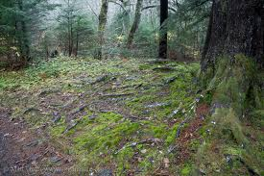
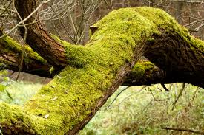
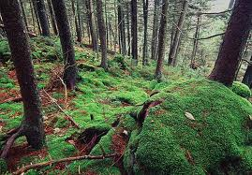
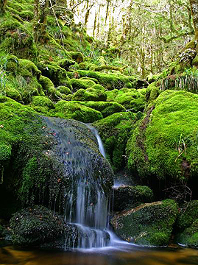
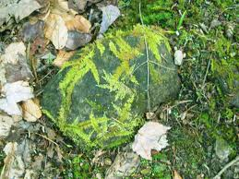
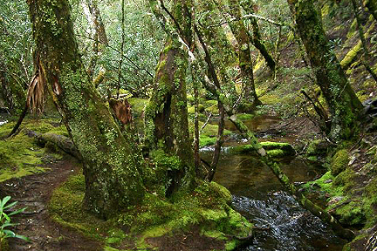
BRYOPHYTE HABITAT

Slide 4
Introduction to Bryophytes
General Characteristics of Plants including Bryophytes II
It appears that the ancestors of plants had a well-developed alternation of heteromorphic generations (i.e. sporophyte/gametophyte), since this type of life cycle is common among the living members of the Plant Kingdom.
The sporophyte is the generation which produces spores which germinate into the gametophyte. The gametophyte is the generation which produces male and female sex cells (gametes) which, during sexual reproduction, fuse into a zygote. The latter develops into a sporophyte.
All plants are oogamous (i.e. exhibit sexual reproduction) and the zygotes of many plants are nutritionally dependent on the gametophyte generation.

Slide 5
Introduction to Bryophytes (cont’d)
General Biology of Bryophytes
“Bryophyte” is a collective term for three distinct divisions of non-vascular plants, which include:
The mosses (Division Bryophyta),
The hornworts (Division Anthocerotophyta), and
The liverworts (Division Hepatophyta).
There are about 23,000 different species of bryophytes, all of which lack true xylem or phloem.
The habitats of bryophytes range in elevation from sea level near ocean beaches to more than 18,000 feet (5,486 meters) above sea level on mountains.
They often occur as soft, green mats on damp banks, trees and logs; but some (e.g. Grimmia spp.) are able to withstand long periods of desiccation and are found on bare rocks in the scorching sun.
Some bryophyte species are restricted to very specific habitats; e.g. on the antlers and bones of dead reindeer; in the dung of herbivorous animals or dung of carnivorous animals; and also on large insect wing covers.

Slide 6
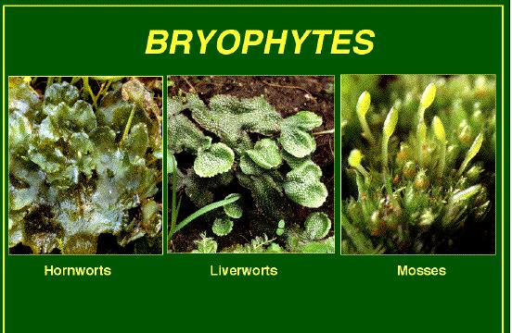
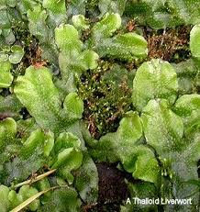
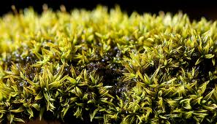
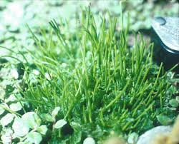
Liverworts
Mosses
Hornworts

Slide 7
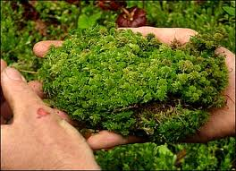
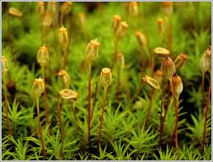
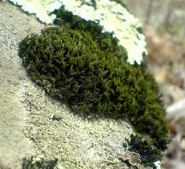
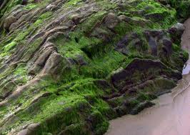
Introduction to Bryophytes (cont’d)
Structure and Form of Bryophytes I
Mosses (Division Bryophyta)
There are three distinct classes of mosses commonly called
peat mosses (e.g. Sphagnum sp.),
true mosses (e.g. Polytrichum sp.), and
rock mosses
Peat moss
True moss
Rock moss

Slide 8
In all three classes, the gametophyte is the dominant plant body.
The stems of moss gametophytes may be erect or tufted as in Brachymenium sp. or prostrate as in Ectropothecium sp.
Many mosses have water-conducting cells called hydroids and some have food-conducting cells called leptoids surrounding the hydroids, but these cells do not conduct as efficiently as the vascular tissues in higher plants.
Mosses are anchored by filamentous multicellular rhizoids.
Their leaves are never lobed or divided nor do they have a petiole.

Slide 9
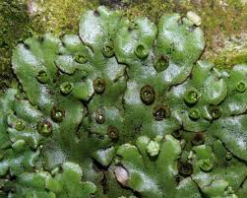
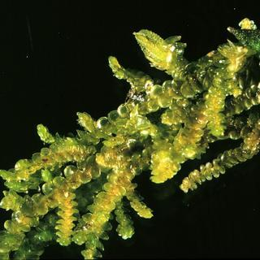
Introduction to Bryophytes (cont’d)
Structure and Form of Bryophytes II
Liverworts (Division Hepatophyta)
The most common members of this group of bryophytes are called thalloid liverworts because of their flattened, lobed, somewhat leaf-like bodies (e.g. Marchantia sp.)
They, however, constitute only 20% of the roughly 8,000 species of liverworts.
The remaining 80% are “leafy” and superficially resemble mosses (e.g. Frullania sp,).
Growth in the liverworts is prostrate rather than upright and the plant body is anchored by unicellular rhizoids.
Marchantia
Frullania

Slide 10
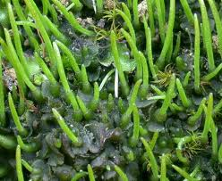
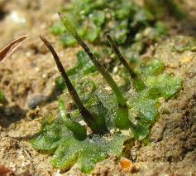
Introduction to Bryophytes (cont’d)
Structure and Form of Bryophytes III
Hornworts (Division Anthocerotophyta)
Although the gametophytes of hornworts superficially resemble those of thalloid liverworts, there are many features that separate hornworts from other bryophytes:
Hornworts usually have only one chloroplast in each cell (a few species have up to eight) and each chloroplast has pyrenoids similar to those found in green algae.
They are often rosette-like in form.
In contrast to the air-filled pores and cavities of thalloid liverworts, hornworts have pores and cavities filled with mucilage. Cyanobacteria (nitrogen-fixing blue-green algae) often grow in the mucilage.
Hornworts are also anchored by rhizoids. The most common species belong to the genus Anthoceros.
Anthoceros

Slide 11
Introduction to Bryophytes
Modes of Reproduction in Bryophytes
All bryophytes require an external source of water (either as rain or dew) in order to reproduce. Bryophytes reproduce both sexually and asexually.
Alternation of generations is a characteristic feature in their life cycle, with the gametophyte being the conspicuous and dominant generation. Mosses and liverworts have unisexual gametophytes. The gametophytes of some species of hornworts (e.g. Anthoceros sp.) are also unisexual, but others are bisexual.
The gametophytes bear antheridia and archegonia which contain the male and female sex cells respectively. These fuse to form a zygote which grows into the sporophyte.

Slide 12
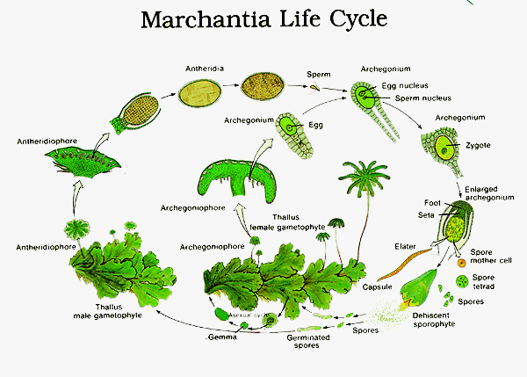
In all bryophytes, the sporophytes are permanently attached to the gametophytes, but vary in their dependence on them.
Asexual reproduction in liverworts (e.g. Marchantia sp.) is by means of gemmae (singular: gemma), which are produced in gemmae cups scattered all over the upper surface of the liverwort gametophyte. While in the cup, development of the gemma is inhibited by the presence of lunularic acid but, once out of the cap, each gemma is capable of growing into a new thallus.
Asexual reproduction in hornworts is primarily by fragmentation.

Slide 14
Introduction to Bryophytes (cont’d)
ECONOMIC IMPORTANCE OF BRYOPHYTES I
In Ecological Restoration
Some bryophytes and lichens are the first to colonize bare rocks after volcanic eruptions or other geological upheavals. They are, therefore, pioneers of succession and, by their gradual accumulation of minerals and organic matter, create conditions that favour the growth of other organisms.
As Biological Indicators
Some mosses grow only in calcium-rich soils whereas the presence of others indicates higher than usual soil acidity or salinity. Some mosses, when found growing in a dry area, are a good indication that the area receives running water during some part of the year.
As Packaging Material
Some mosses have been used for cushioning in the packing of dishes and other breakable objects, while some have been used for stuffing furniture.

Slide 15
Introduction to Bryophytes (cont’d)
ECONOMIC IMPORTANCE OF BRYOPHYTES II
For soil conditioning
1 kg of dry peat moss (e.g. Sphagnum sp.) is capable of absorbing up to 25 kg of water. Peat mosses are, therefore, very useful soil conditioners and have been used in nurseries and as components of potting mixtures.
As Preservative
Peat mosses have a natural acidity which inhibits fungal and bacterial growth. They have, therefore, been used in shipping live shellfish and other organisms.
In Medicine
The antiseptic and absorptive capacities of peat moss have made it a useful poultice material for application to wounds. This property of peat mosses was identified during World War I when a species of Sphagnum was used as a substitute for cotton bandages. It was observed that fewer infections developed in the wounds bandaged with Sphagnum.
For Plant Propagation
Sphagnum and other mosses have also been used in vegetative plant propagation, particularly for air layering.

